Slide 1
Module 4 Semiconductor devices

Slide 2
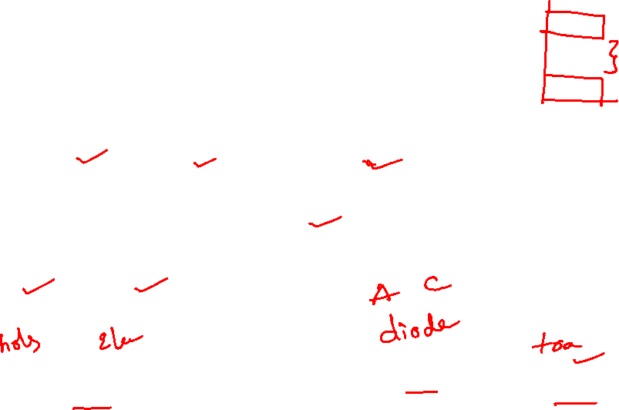
1. Semiconductor Theory
Semiconductor
Insulators, Semiconductors and Conductors (Energy level, Valance band & Conduction band)
Semiconductor Materials – Group IV Elements
Doping
Intrinsic & Extrinsic Semi Conductors
p-type & n-type semi conductors
Semiconductor Devices
Types of Semiconductor Devices – Two Terminal, Three Terminal and Four Terminal Devices

Slide 3
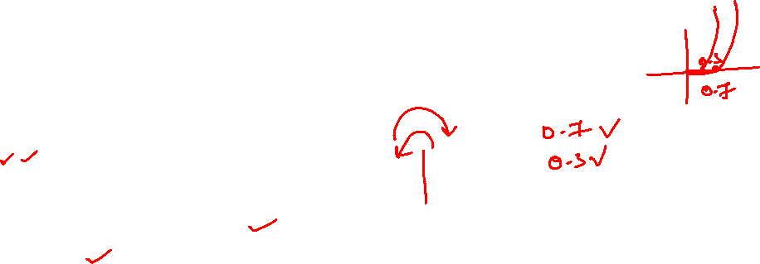
2. PN Junction
PN Junction
How PN Junction Formed
Diffusion
Potential Barrier
Depletion Layer
Neutral Charge Condition

Slide 4
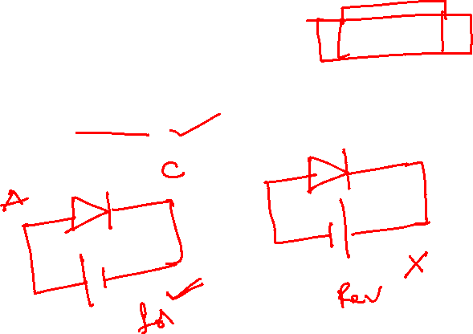
3. PN Junction Diode
PN Junction Diode (conduct the current in one direction only)
Construction of Diode
Diffusion
Potential Barrier
Symbol, VI Characteristics
Unbiased Diode
Biased Diode
Forward Biased
Reverse Biased

Slide 5

4. Application of Diode - Rectifiers
Halfwave Rectifier & Full Wave Rectifier

Slide 6
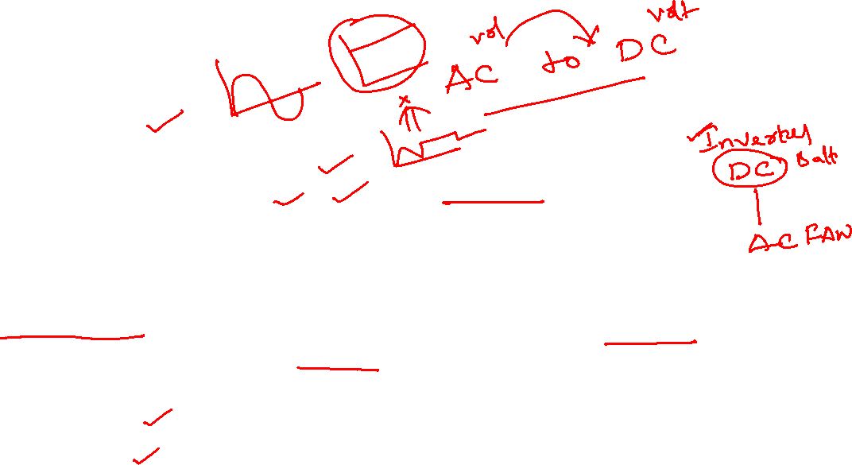
Rectifiers
The main application of p-n junction diode is in rectification circuits.
These circuits are used to describe the conversion of a.c signals to d.c in power supplies.
Diode rectifier gives an alternating voltage which pulsates in accordance with time.
The filter smoothes the pulsation in the voltage and to produce d.c voltage, a regulator is used which removes the ripples.
There are two primary methods of diode rectification:
Half Wave Rectifier
Full Wave Rectifier

Slide 7
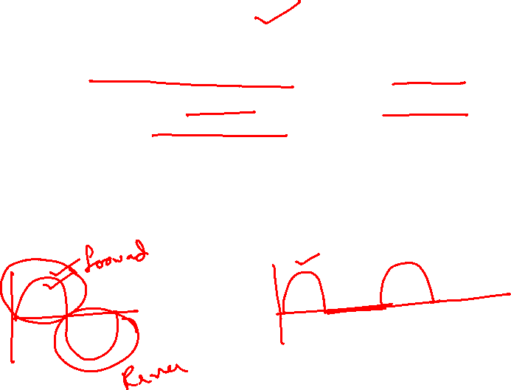
Half Wave Rectifier
In a half-wave rectifier, one half of each a.c input cycle is rectified.
When the p-n junction diode is forward biased, it gives little resistance and when it is reversing biased it provides high resistance.
During one-half cycles, the diode is forward biased when the input voltage is applied and in the opposite half cycle, it is reverse biased.
During alternate half-cycles, the optimum result can be obtained.

Slide 8
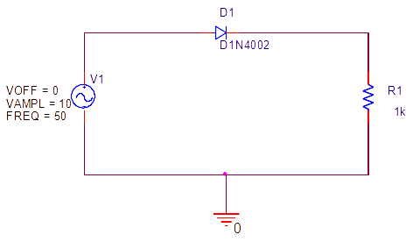
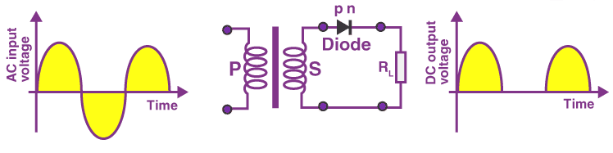
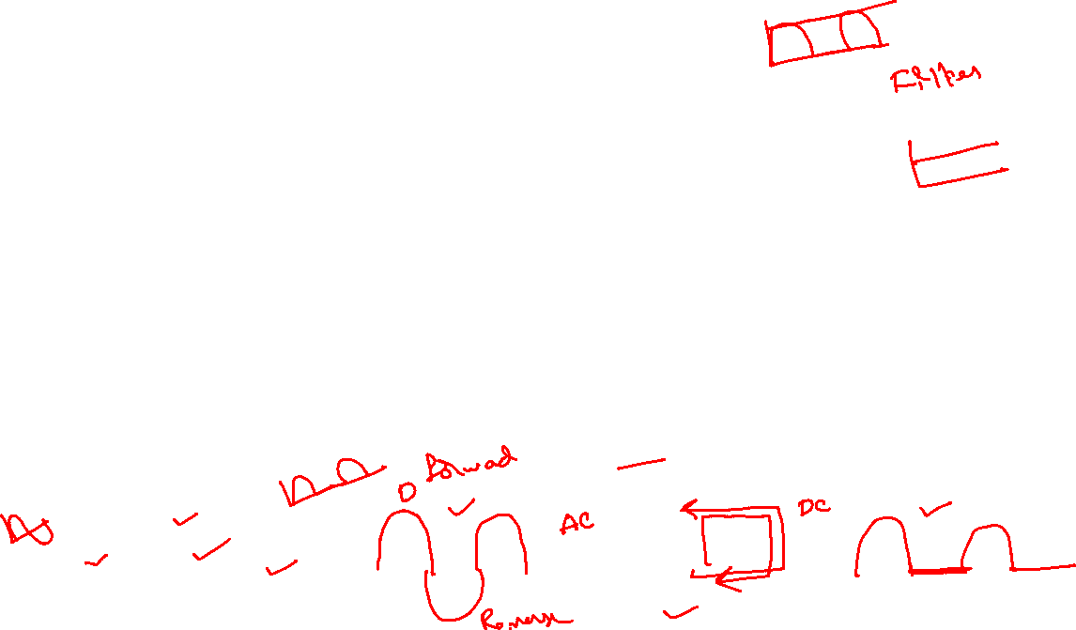
Working of Half Wave Rectifier
The half-wave rectifier has both positive and negative cycles.
During the positive half of the input, the current will flow from positive to negative which will generate only a positive half cycle of the a.c supply.
In the second half cycle, the current will flow from negative to positive and the diode will be reverse biased.
Thus, at the output side, there will be no current generated, and we cannot get power at the load resistance.

Slide 9
Characteristics of Half Wave Rectifier
1. Ripple Factor
2. DC Current
3. DC Output Voltage
4. Form factor
5. Rectifier Efficiency
Advantages
Disadvantages
Applications

Slide 10

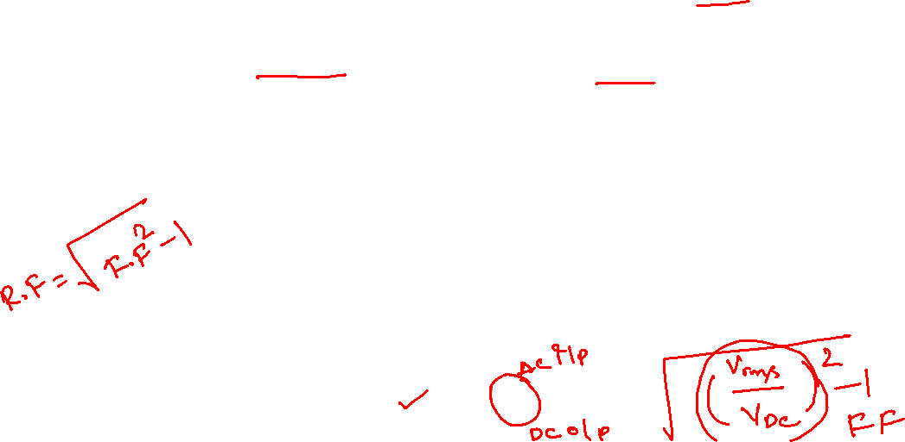
Half Wave Rectifier – Ripple Factor
Ripples are the oscillations that are obtained in DC which is corrected by using filters such as inductors and capacitors.
These ripples are measured with the help of the ripple factor and are denoted by γ. Ripple factor tells us the number of ripples presents in the output DC.
Higher the ripple factor, more is the oscillation at the output DC and lower is the ripple factor, less is the oscillation at the output DC.
Ripple factor is the ratio of RMS value of the AC component of the output voltage to the DC component of the output voltage.

Slide 11


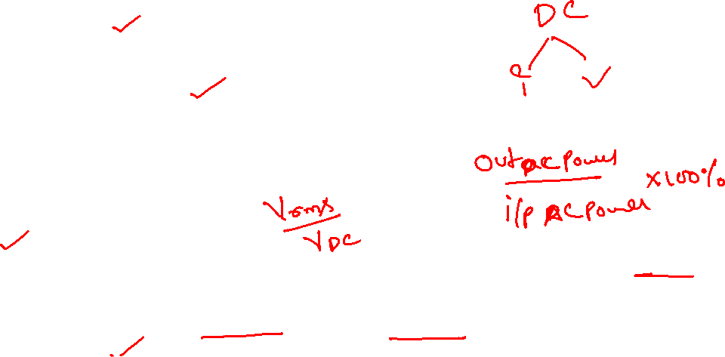
Half Wave Rectifier – Characteristics
DC Current
Imax is the maximum DC load current
DC Output Voltage
The output DC voltage appears at the load resistor RL which is obtained by multiplying output DC voltage with the load resistor RL.
The output DC voltage is given as:
VSmax is the maximum secondary voltage
Form Factor
The form factor is the ratio of RMS value to the DC value. For a half-wave rectifier, the form factor is 1.57.
Rectifier Efficiency
Rectifier efficiency is the ratio of output DC power to the input AC power. For a half-wave rectifier, rectifier efficiency is 40.6%.

Slide 12
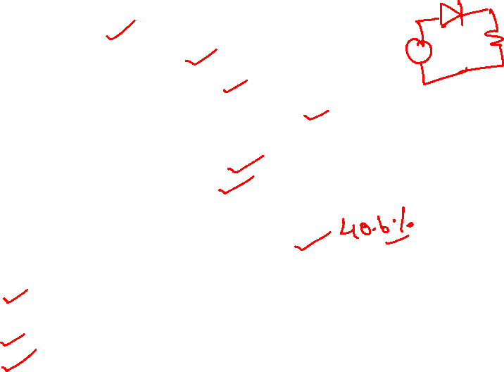
Advantages of Half Wave Rectifier
Affordable
Simple connections
Easy to use as the connections are simple
Number of components used are less
Disadvantages of Half Wave Rectifier
Ripple production is more
Harmonics are generated
Utilization of the transformer is very low
The efficiency of rectification is low
Applications of Half Wave Rectifier
Power rectification: Half wave rectifier is used along with a transformer for power rectification as powering equipment.
Signal demodulation: Half wave rectifiers are used for demodulating the AM signals.
Signal peak detector: Half wave rectifier is used for detecting the peak of the incoming waveform.

Slide 13

Full Wave Rectifier
Full-wave rectifier circuits are used for producing an output voltage or output current which is purely DC.
The main advantage of a full-wave rectifier over half-wave rectifier is that such as the average output voltage is higher in full-wave rectifier, there is less ripple produced in full-wave rectifier when compared to the half-wave rectifier.
The full-wave rectifier utilizes both halves of each a.c input. When the p-n junction is forward biased, the diode offers low resistance and when it is reversing biased it gives high resistance.
The circuit is designed in such a manner that in the first half cycle if the diode is forward biased then in the second half cycle it is reverse biased and so on.

Slide 14
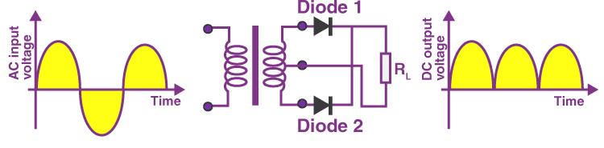
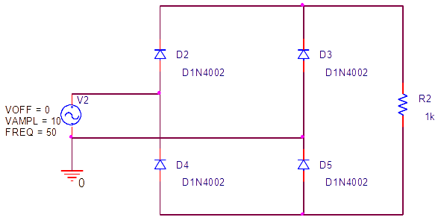
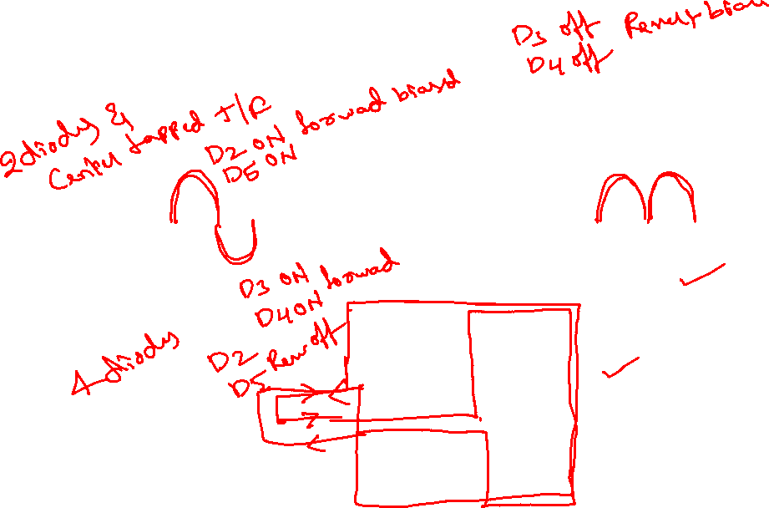
Full wave rectifier

Slide 15



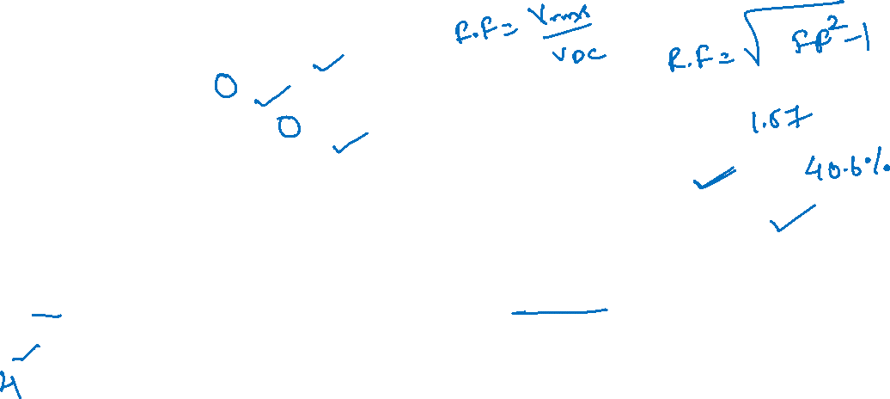
Characteristics of Full Wave Rectifier
Ripple Factor
DC Current
DC Output Voltage
Form Factor - The form factor of a full-wave rectifier is given as 1.11
Rectifier Efficiency - The rectifier efficiency of a full-wave rectifier is 81.2%.
Types of Full Wave Rectifier
There are two main types of full-wave rectifiers, and they are:
Two diodes full-wave rectifier circuit (requires a center-tapped transformer and is used in vacuum tubes)
Bridge rectifier circuit (doesn’t require a centre-tapped transformer and is used along with transformers for efficient usage)

Slide 16

Advantages of Full Wave Rectifier
The rectifier efficiency of a full-wave rectifier is high
The power loss is very low
Number of ripples generated are less
Disadvantages of Full Wave Rectifier
Very expensive
Applications of Full Wave Rectifier
Following are the uses of full-wave rectifier:
Full-wave rectifiers are used for supplying polarized voltage in welding and for this bridge rectifiers are used.
Full-wave rectifiers are used for detecting the amplitude of modulated radio signals.

Slide 17

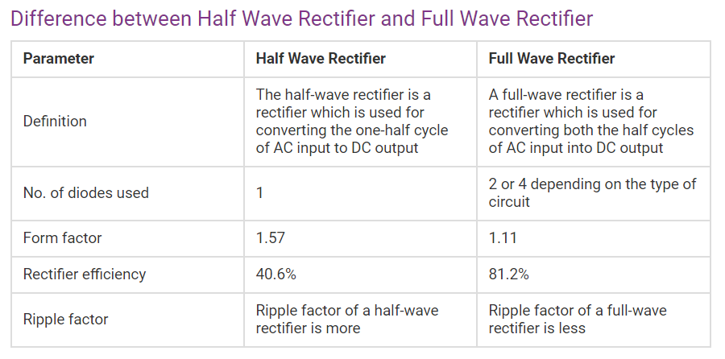

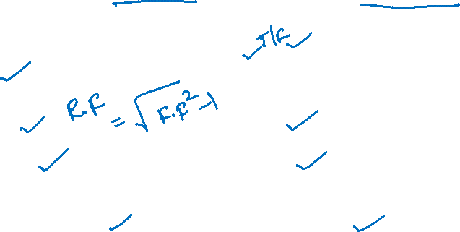

Slide 18
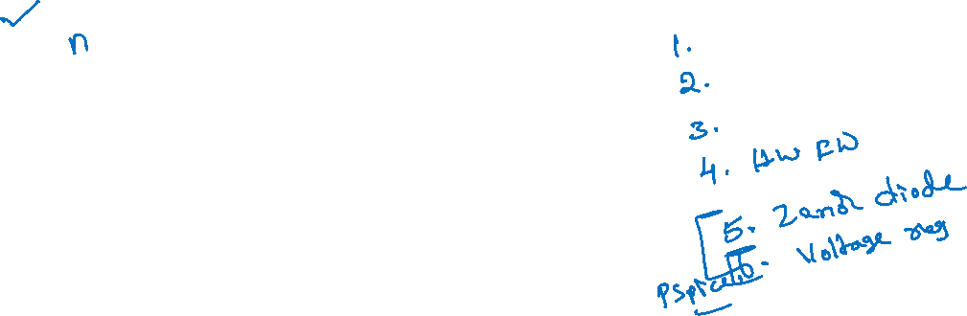
quiz
The p-region has a greater concentration of __________ as compared to the n-region in a P-N junction.
a) holes
b) electrons
c) both holes & electrons
d) phonons
A

Slide 19
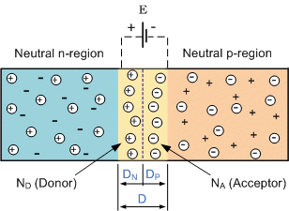
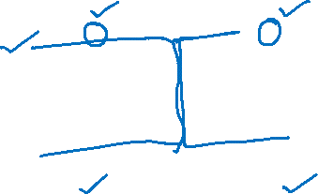
quiz
A p-type semiconductor material is doped with ____________ impurities whereas a n-type semiconductor material is doped with __________ impurities
a) acceptor, donor
b) acceptor, acceptor
c) donor, donor
d) donor, acceptor
A

Slide 20

quiz
In the p & n regions of the p-n junction the _________ & the ___________ are the majority charge carriers respectively.
a) holes, holes
b) electrons, electrons
c) holes, electrons
d) electrons, holes
C

Slide 21
quiz
The n-region has a greater concentration of _________ as compared to the p-region in a P-N junction diode.
a) holes
b) electrons
c) both holes & electrons
d) phonons
B

Slide 22
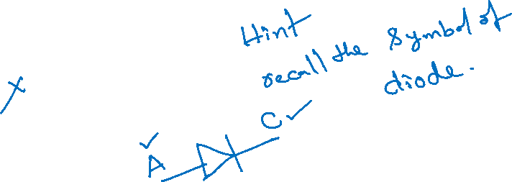
quiz
Which of the below mentioned statements is false regarding a p-n junction diode?
a) Diode are uncontrolled devices
b) Diodes are rectifying devices
c) Diodes are unidirectional devices
d) Diodes have three terminals
D

Slide 23
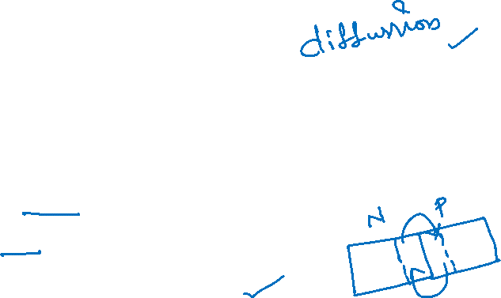
quiz
When a physical contact between a p-region & n-region is established which of the following is most likely to take place?
a) Electrons from N-region diffuse to P-region
b) Holes from P-region diffuse to N-region
c) Both of the above mentioned statements are true
d) Nothing will happen
C

Slide 24
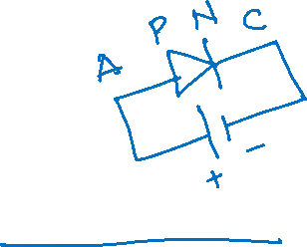
quiz
Which of the following is true in case of a forward biased p-n junction diode?
a) The positive terminal of the battery sucks electrons from the p-region
b) The positive terminal of the battery injects electrons into the p-region
c) The negative terminal of the battery sucks electrons from the p-region
d) None of the above mentioned statements are true
A

Slide 25
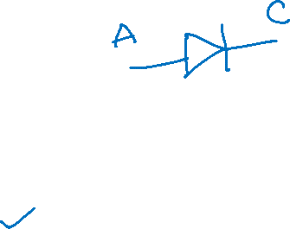
quiz
Power diode is __________
a) a three terminal semiconductor device
b) a two terminal semiconductor device
c) a four terminal semiconductor device
d) a three terminal analog device
B

Slide 26
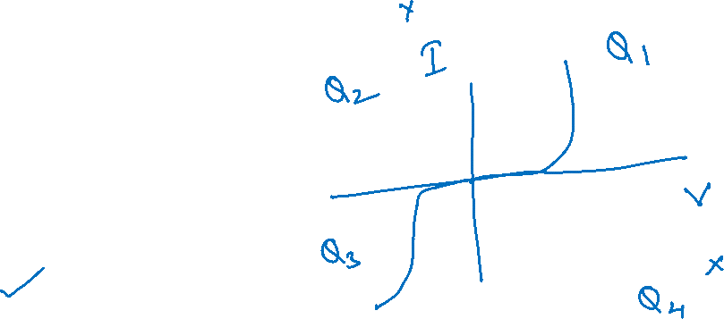
quiz
The V-I Characteristics of the diode lie in the
a) 1st & 2nd quadrant
b) 1st & 3rd quadrant
c) 1st & 4th quadrant
d) Only in the 1st quadrant
B

Slide 27
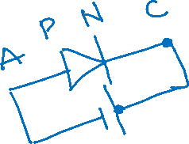
quiz
A diode is said to be reversed biased when the
a) cathode is positive with respect to the anode
b) anode is positive with respect to the cathode
c) cathode is negative with respect to the anode
d) both cathode & anode are negative
A

Slide 28
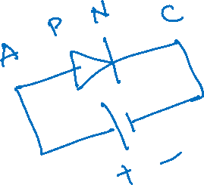
quiz
A diode is said to be forward biased when the
a) cathode is positive with respect to the anode
b) anode is positive with respect to the cathode
c) anode is negative with respect to the anode
d) both cathode & anode are positive
B

Slide 29
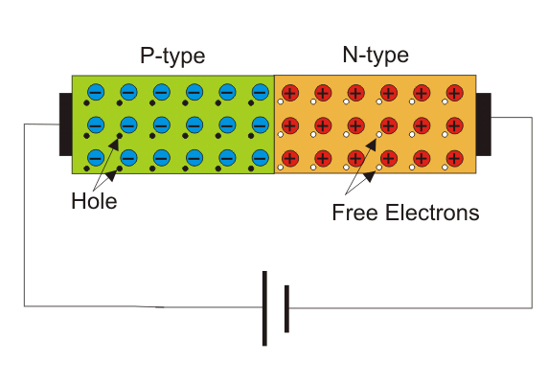
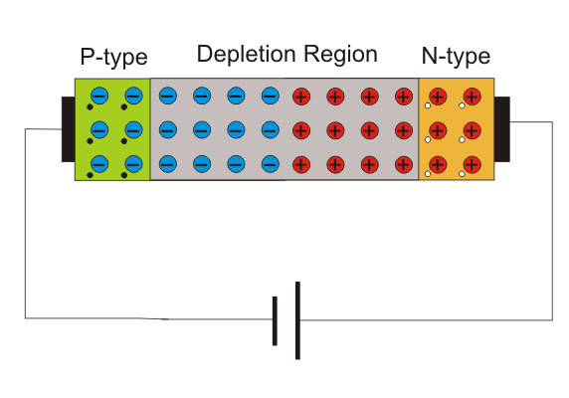
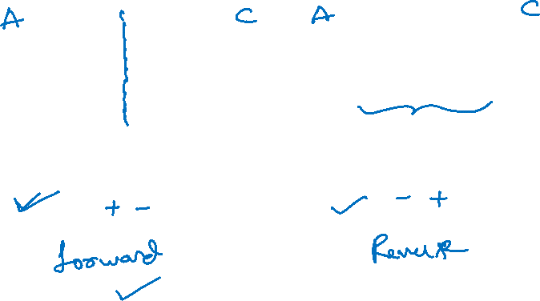
quiz
When the p-n junction diode is forward biased, the width of the depletion region __________
a) increases
b) decreases
c) remains Constant
d) increases than Decreases
B

Slide 30
quiz
When the p-n junction diode is reversed biased, the width of the depletion region __________
a) increases
b) decreases
c) remains Constant
d) none of the above mentioned
A

Slide 31
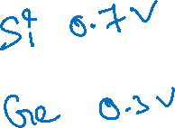
quiz
In the equilibrium state, the barrier potential across a unbiased silicon diode is _________
a) 0.3 V
b) 0.7 V
c) 1.3 V
d) 0 V
B

Slide 32
quiz
In the equilibrium state the barrier, potential across a unbiased germanium diode is __________
a) 0.3 V
b) 0.7 V
c) 1.7 V
d) 0 V
A

Slide 33

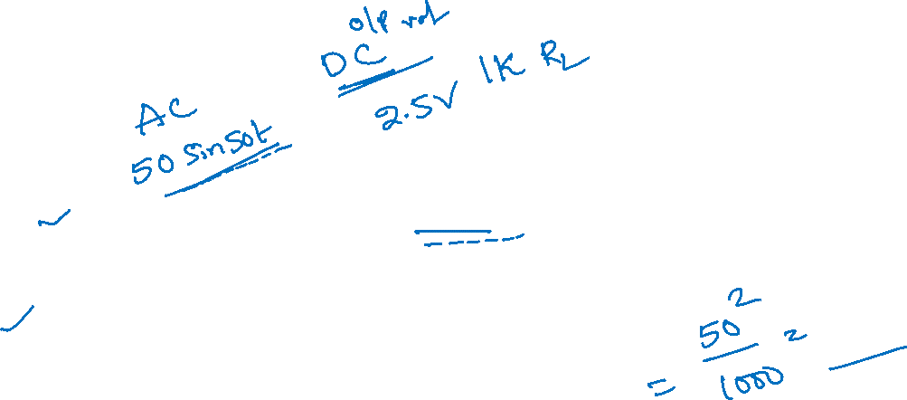
quiz
In a half wave rectifier, the sine wave input is 50sin50t. If the load resistance is of 1K, then average DC power output will be?
a) 3.99V
b) 2.5V
c) 5.97V
d) 6.77V
B

Slide 34
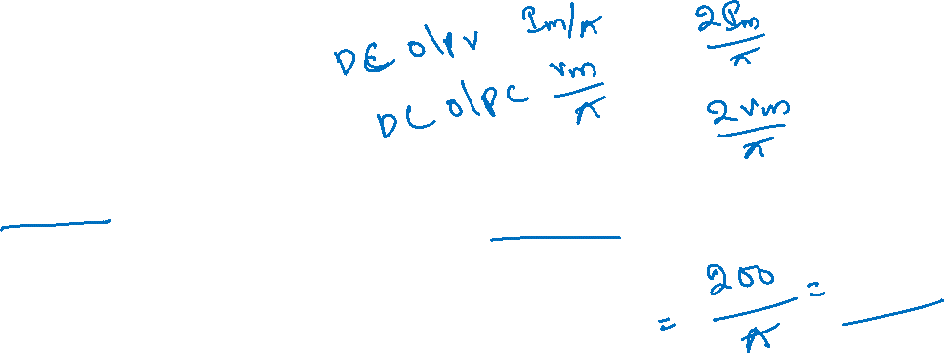

quiz
In a half wave rectifier, the sine wave input is 200sin300t. The average value of output voltage is?
a) 57.876V
b) 67.453V
c) 63.694V
d) 76.987V
C

Slide 35
quiz
Efficiency of a half wave rectifier is
a) 50%
b) 60%
c) 40.6%
d) 46%
C

Slide 36
quiz
Form factor of a half wave rectifier is
a) 1.11
b) 1.57
c) 1.21
d) 1.31
B

Slide 37
quiz
Efficiency of a full wave rectifier is _________
a) 50%
b) 46%
c) 70%
d) 81.2%
D

Slide 38
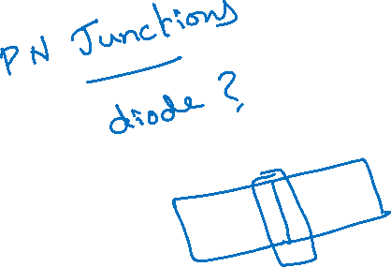
quiz
How many junction/s do a diode consist?
a) 0
b) 1
c) 2
d) 3
B

Slide 39

quiz
A single-phase full wave mid-point type diode rectifier requires __________ number of diodes whereas bridge type requires _________
a) 1,2
b) 2,4
c) 4,8
d) 3,2
B

Slide 40
quiz
A single-phase full wave rectifier is a
a) single pulse rectifier
b) multiple pulse rectifier
c) two pulse rectifier
d) three pulse rectifier
C

Slide 41

5. Zenor diode

Slide 42
6. Application of Zenor diode – Voltage Regulators

